Slide 1

ADVENTURE WORKS ANALYTICS
PRESENTED BY: KINJAL GOHIL

Slide 2
01
05
Machine Learning Analysis
Introduction
Problem Statement
02
06
SQL Insight Report
Content of Adventure Works
03
07
Dashboard Insight Report
SQL Analysis
Dashboard Analysis
04
08
Machine Learning Insight Report

Slide 3
Introduction
01
Adventure Works Cycles is a renowned manufacturer specializing in mountain bikes, cycling apparel, and key bicycle components. The company is committed to providing high-quality, durable products that enhance performance, safety, and comfort for cyclists of all levels. With a focus on innovation and style, Adventure Works caters to enthusiasts and professionals alike, offering a complete cycling experience.

Slide 4
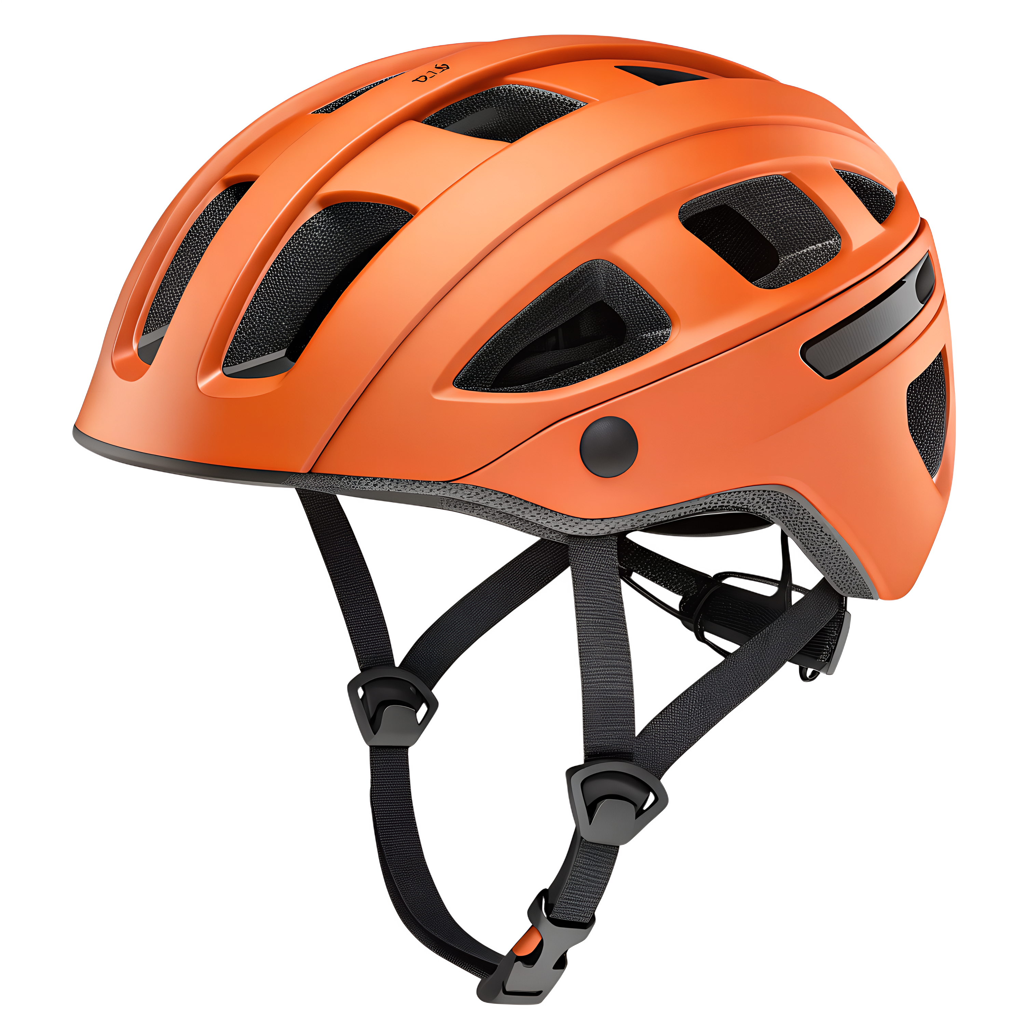
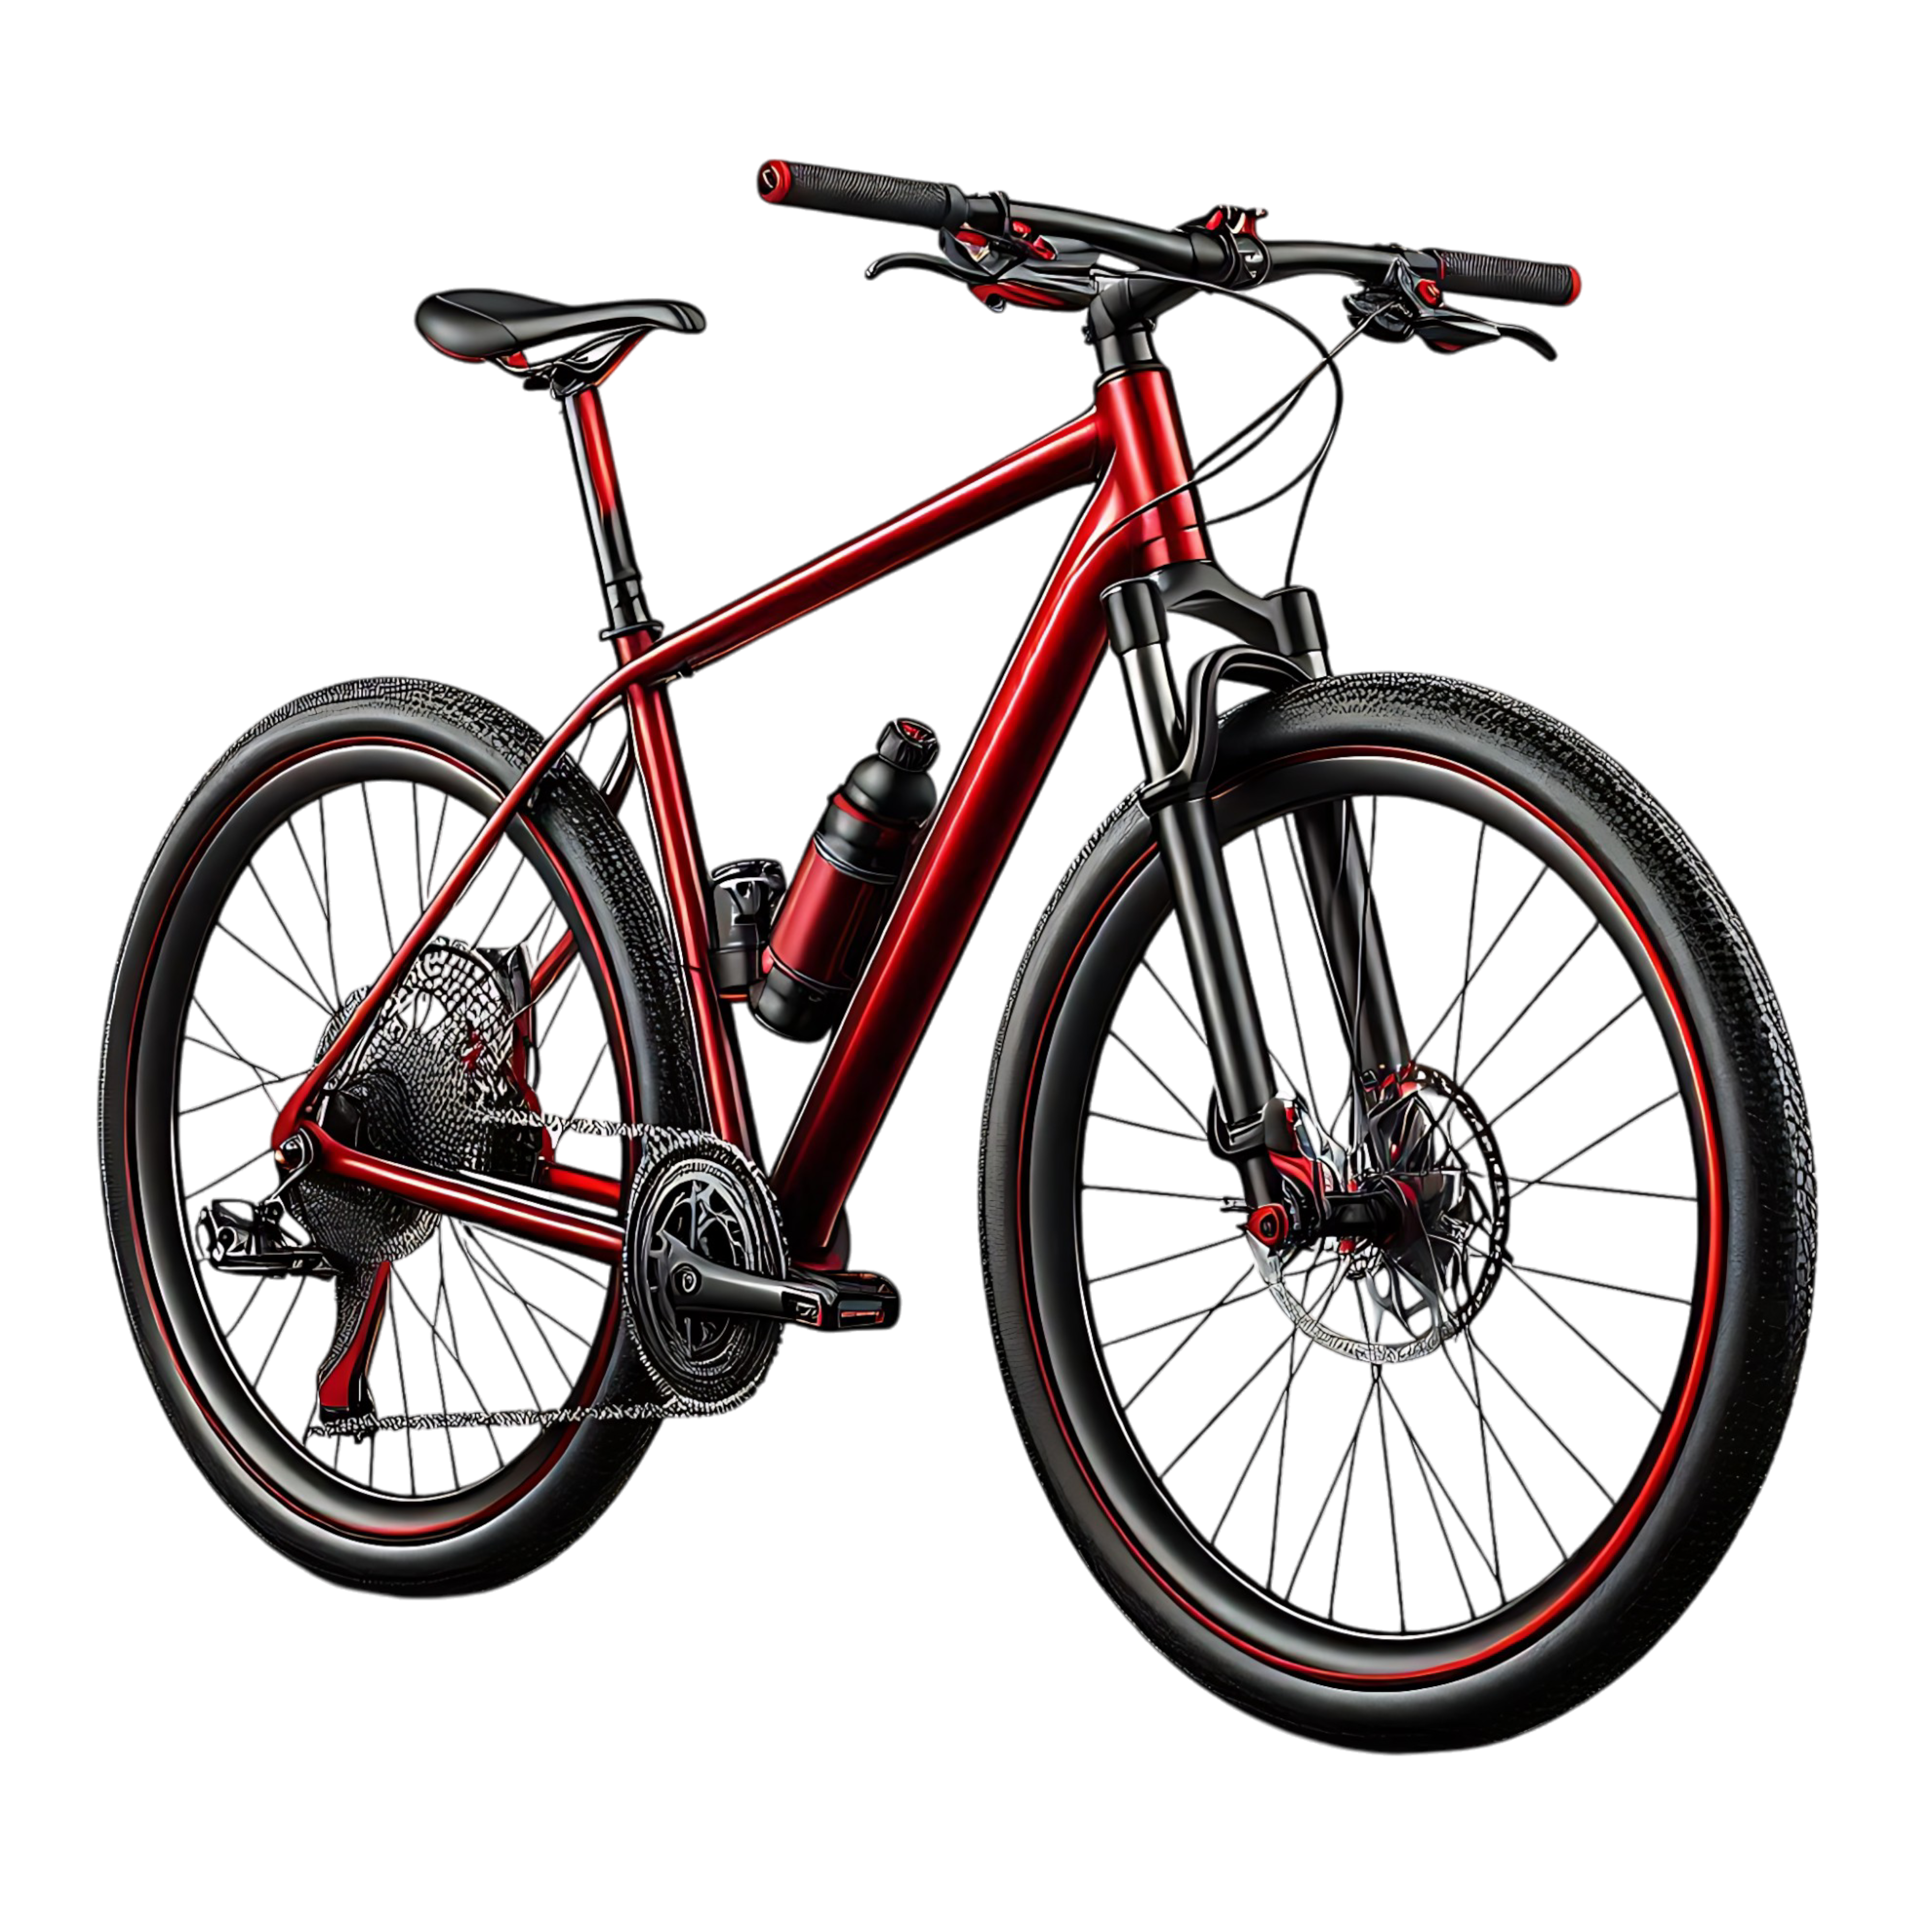

Product Categories
Bicycle Accessories:
Safety, comfort, style, performance.
Component:
Individual Parts that make up a whole.
Bicycle:
Human-Powered
Vehicle with two wheels for
transportation
Clothing:
Apparel designed
for comfort, safety,
and performance.

Slide 5

Impact of Gender Distribution on Revenue Performance
Female
Male
$12.52M revenue
12k orders placed
$1009 avg order value
$12.24M revenue
13k orders placed
$973 avg order value
Total Customer: 49.3%
Total Customer: 50.7%

Slide 6
Problem Statement
02
02
01
Adventure Works Cycles lacks consolidated insights into sales performance, customer behavior, and product trends across regions, limiting strategic decision-making.
The company needs to identify top-performing products, high-value customers,
and underperforming regions to optimize revenue and marketing efforts.
03
Current data is siloed across multiple tables and formats, making it difficult to generate actionable,
real-time business intelligence.
04
Predicting future sales trends and understanding customer purchasing patterns is challenging without
integrated analytics and predictive modeling.
05
There is a need to develop interactive dashboards and reports to enable stakeholders to monitor
KPIs and make data-driven decisions efficiently.

Slide 7
03
SQL Analysis
Objective: Extract strategic insights from Adventure Works operational data covering product performance, customer trends, and regional profitability.

Slide 8
Tasks and Business Questions:
01
Annual Revenue Trends
Analyze year-over-year revenue growth and identify peak performing years.
02
Category Performance
Rank product categories by total sales and compare margins across categories.
03
Top & Underperforming Products
Identify the best- and worst-selling products in terms of quantity sold and revenue generation.
04
Customer Segmentation by Spend
Segment customers based on their total lifetime spend (e.g., low, mid, high) and determine their share of total revenue.

Slide 9
05
Geographic Sales Leadership
Identify top countries and regions by total sales and average order size
06
Profitability by Territory
Rank sales territories by profit margin percentage and highlight high-margin regions.
07
Return Analysis
Calculate the return rate per category or product and spotlight items with the highest returns.
08
Sales Seasonality
Detect monthly or quarterly sales peaks and troughs—identify key seasonal patterns.
09
New vs. Returning Customers
Determine revenue contribution from new customers versus repeat purchasers and assess changes over time.

Slide 10
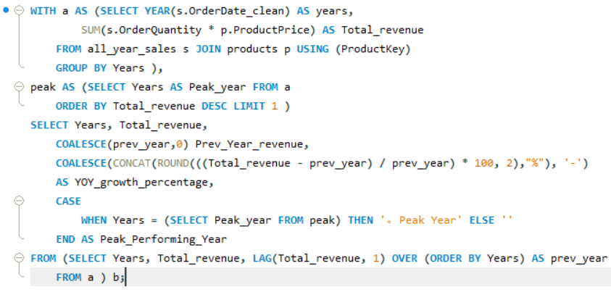
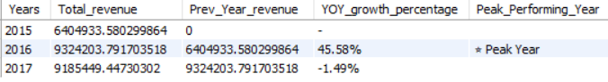
01
Annual Revenue Trends
Analyze year-over-year revenue growth and identify peak performing years.
Input
Output

Slide 11
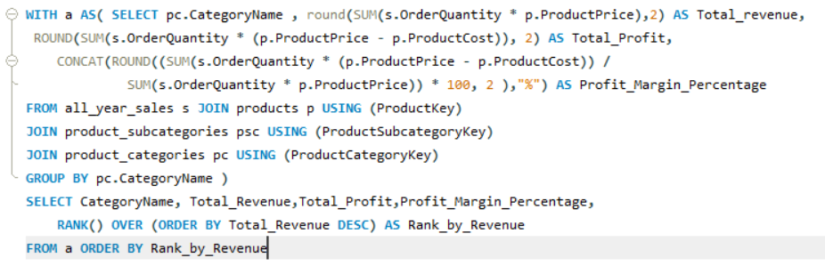
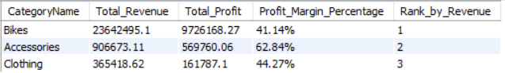
02
Category Performance
Rank product categories by total sales and compare margins across categories.
Input
Output

Slide 12
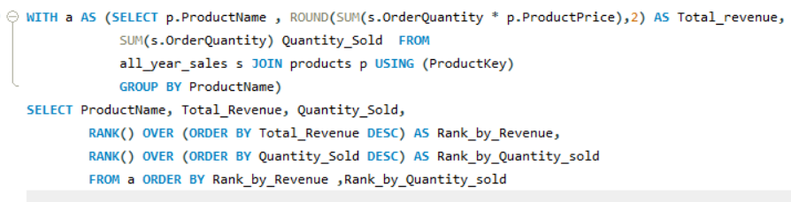
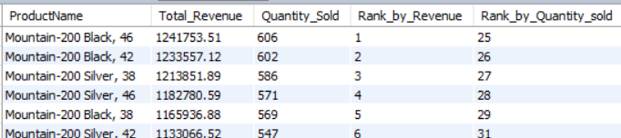
03
Top & Underperforming Products
Identify the best- and worst-selling products in terms of quantity sold and revenue generation.
Input
Output

Slide 13
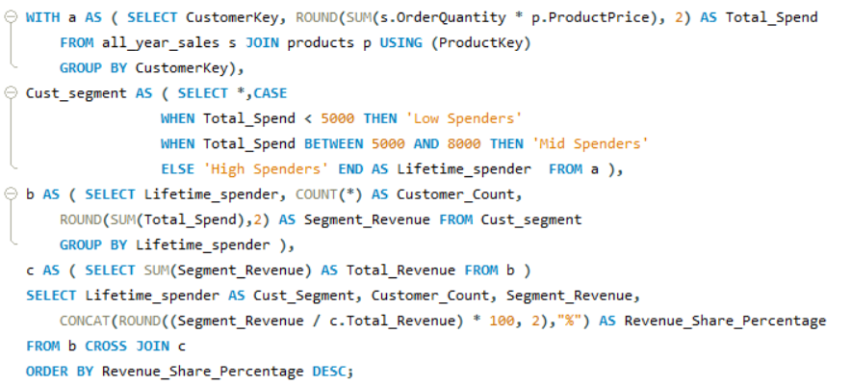
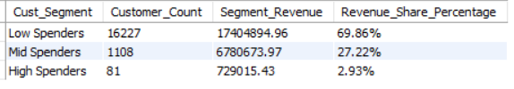
04
Customer Segmentation by Spend
Segment customers based on their total lifetime spend (e.g., low, mid, high) and determine their share of total revenue.
Input
Output

Slide 14
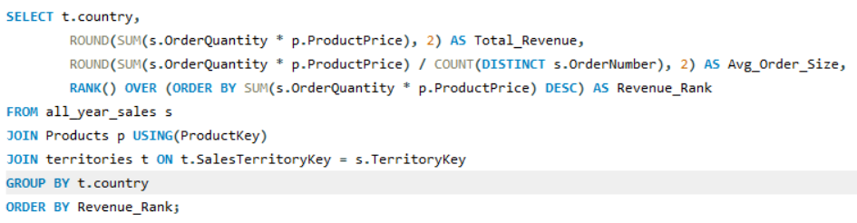
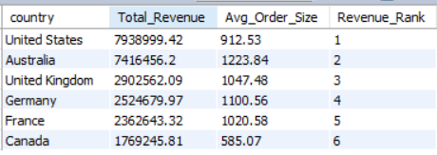
05
Geographic Sales Leadership
Identify top countries and regions by total sales and average order size
Input
Output

Slide 15
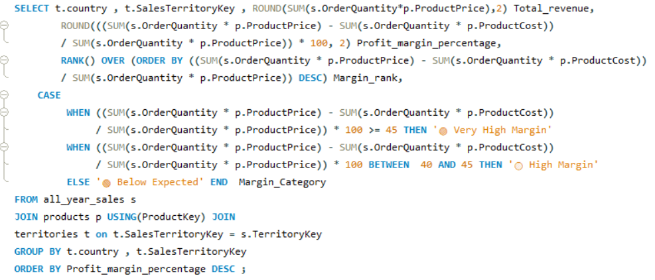
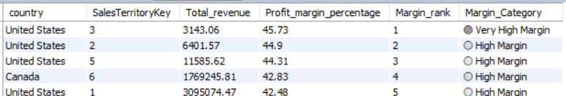
06
Profitability by Territory
Rank sales territories by profit margin percentage and highlight high-margin regions.
Input
Output

Slide 16
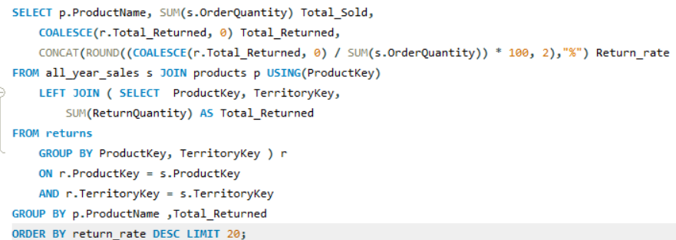
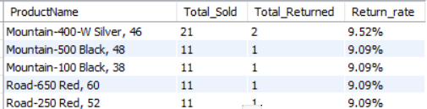
07
Return Analysis
Calculate the return rate per category or product and spotlight items with the highest returns.
Input
Output

Slide 17
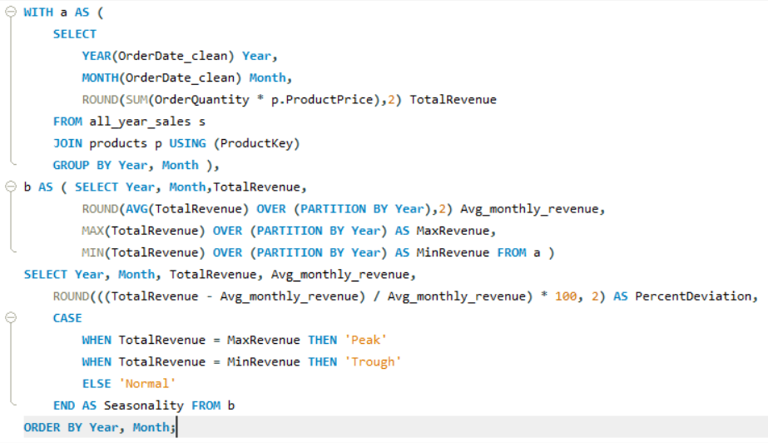
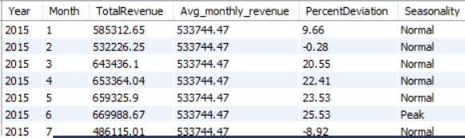
08
Sales Seasonality
Detect monthly or quarterly sales peaks and troughs—identify key seasonal patterns.
Input
Output

Slide 18
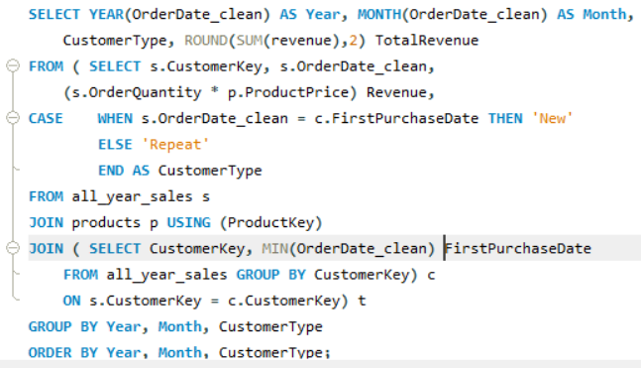
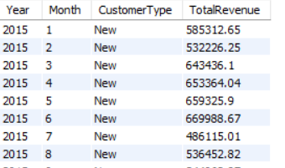
09
New vs. Returning Customers
Determine revenue contribution from new customers versus repeat purchasers and assess changes over time.
Input
Output

Slide 19
04
Dashboard Analysis
Objective: Craft a multi-page interactive dashboard to empower leadership with insights into revenue dynamics, product performance, customer behavior, and regional strategy.

Slide 20
DASHBOARD STRUCTURE
Revenue & Growth
01
KPIs: Total Revenue, YoY Growth Rate, Average Order Value
Visuals: Revenue over time, growth trend lines, category contribution pie chart, channel performance comparison
Product & Category Insights
02
KPIs: Top Categories by Revenue, Highest Return Rates
Visuals: Category ranking bar chart, return rate heatmap, product performance scatter plots, margin band analysis

Slide 21
Customer Analytics
03
KPIs: Number of Customers, Revenue by Segment (Low/Mid/High), Repeat Purchase Rate
Visuals: Customer segmentation tree map, repeat vs new customer revenue over time, average spend distribution chart
Regional Performance
04
KPIs: Revenue by Country/Region, Average Profit Margin by Territory
Visuals: Choropleth map of revenue, region-to-region bar comparisons, territory ranking leaderboard
Seasonality & Channels
05
KPIs: Peak Sales Periods, Channel Mix Performance
Visuals: Monthly/quarterly heatmaps, channel mix pie, seasonal trend lines, channel vs. time comparison

Slide 22
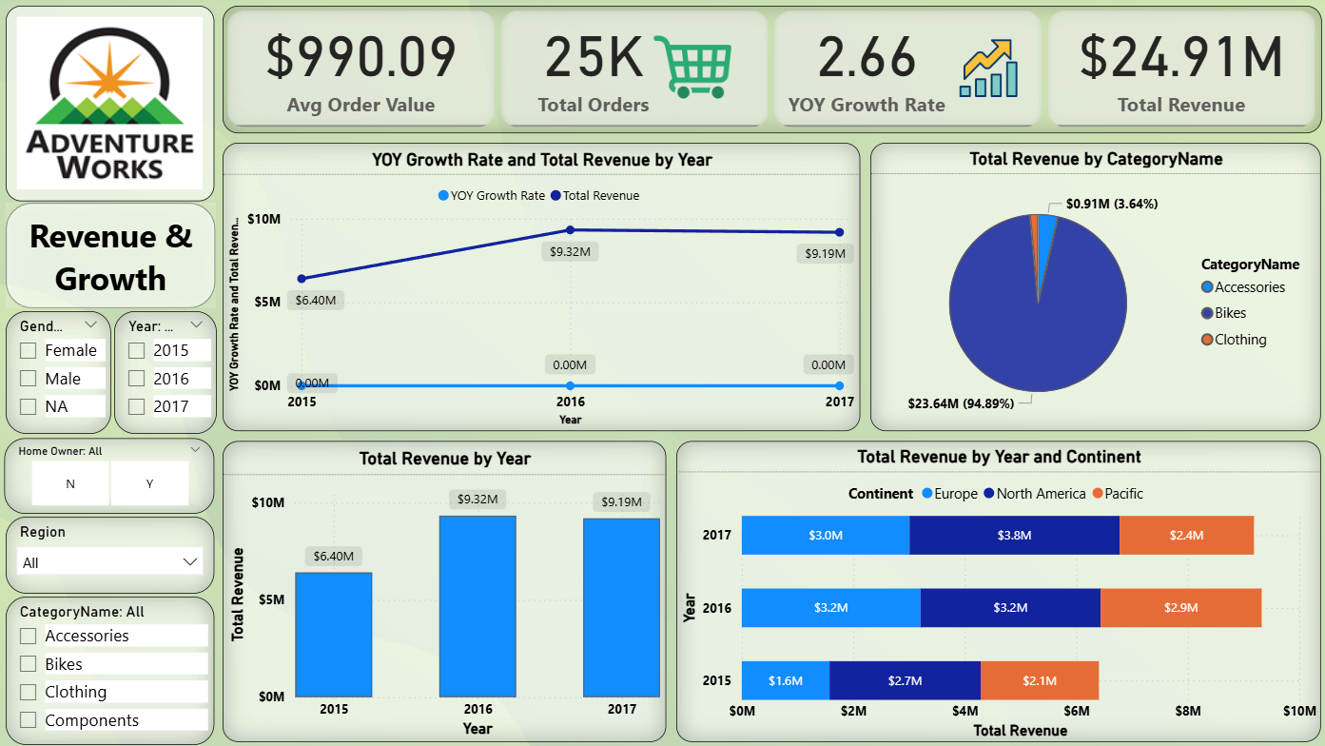

Slide 23
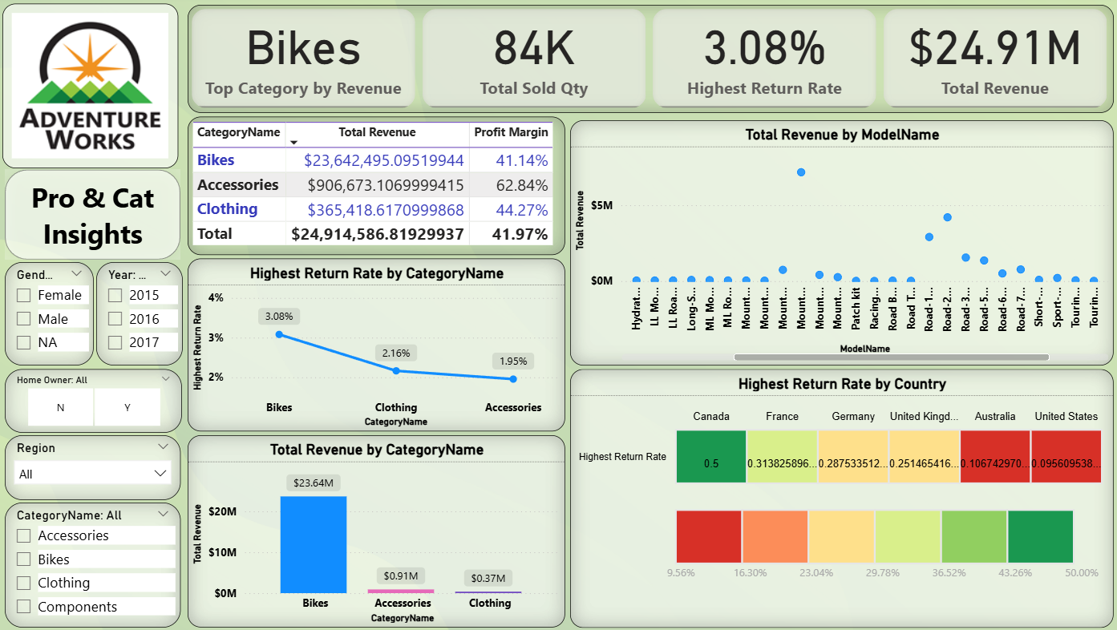

Slide 24
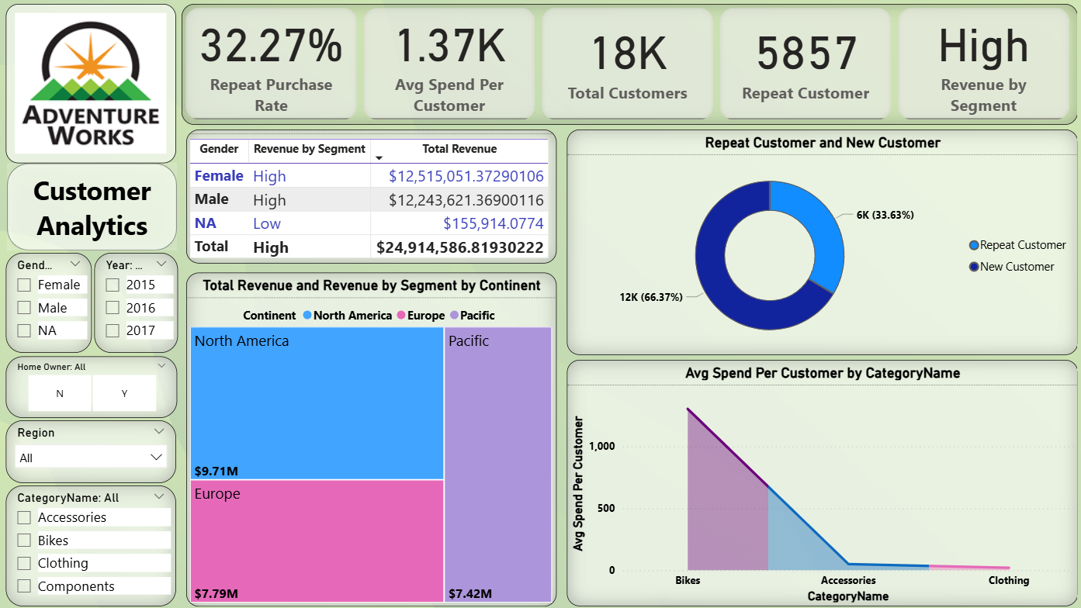

Slide 25
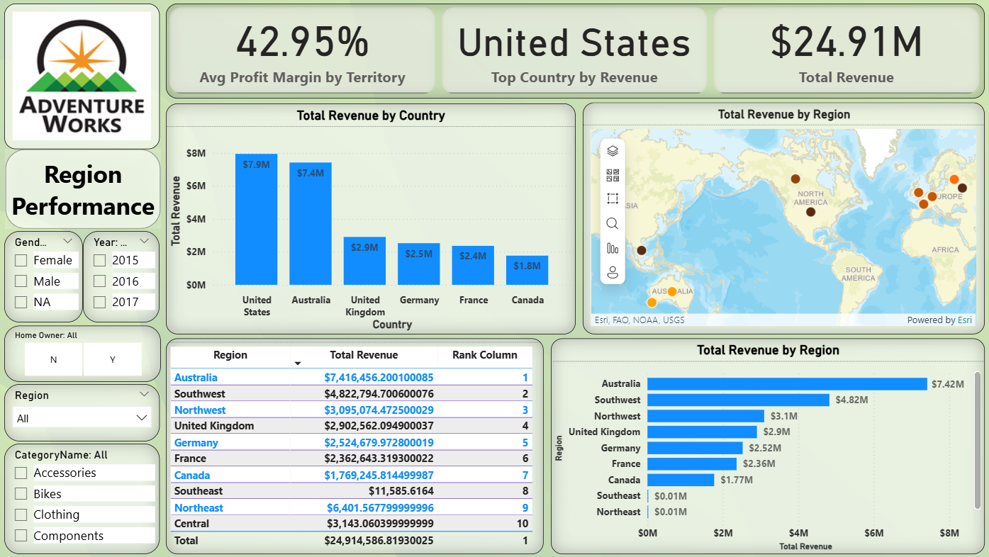

Slide 26
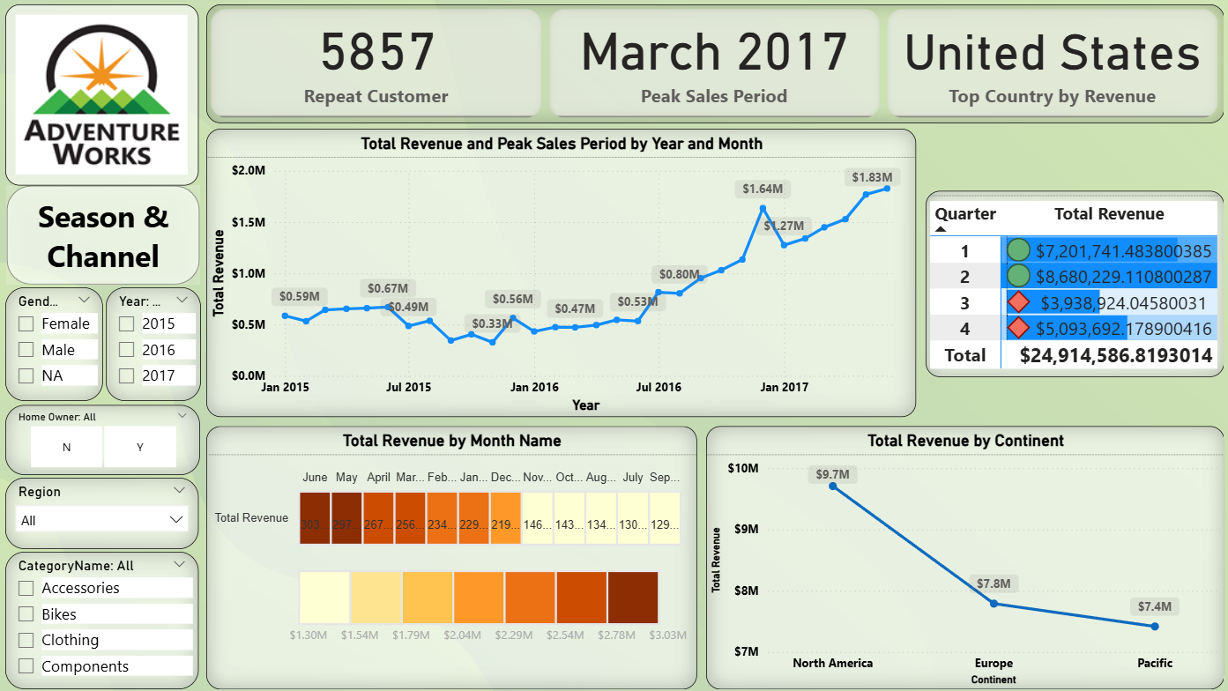

Slide 27
05
Machine Learning Analysis
Objective: Develop predictive models to enhance forecasting, customer targeting, and product lifecycle insights.

Slide 28
🧾 Notebook Overview
The notebook performs sales analysis and forecasting using the Adventure Works dataset.
It focuses on combining sales data across years, cleaning and enriching it, performing trend and seasonal analysis, and using machine learning (Linear Regression) for revenue forecasting.

Slide 29
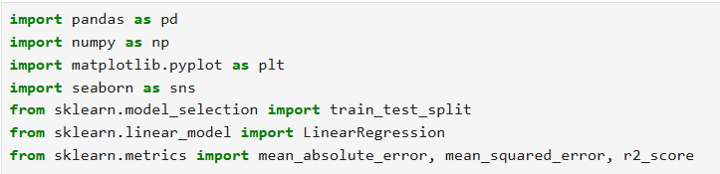
🧾 Part 1: Exploratory Data Analysis
1. Importing Required Libraries
STEP BY STEP EXPLAINATION
Purpose: Import Python libraries for data handling, visualization, and machine learning.
Pandas & NumPy : For data manipulation.
Matplotlib & Seaborn: For visualization.
Sklenar : For regression modelling and performance evaluation.

Slide 30
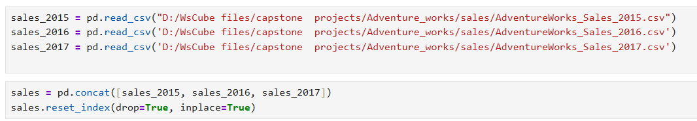
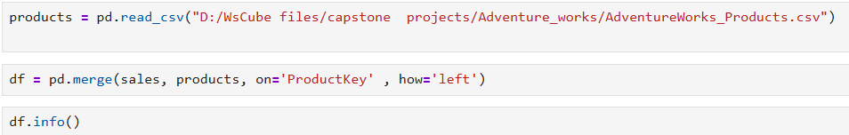
2. Loading Sales Data (2015-2017) & Combining Yearly Sales Data
Each file contains sales transactions for one year.
They include columns like Order Date, Customer Key, Product Key, Order Quantity, and prices. All three years are merged into a single dataset.
The index is reset to make it continuous.
3. Loading Product Data, Merging it with Sales and checking Data Type

Slide 31
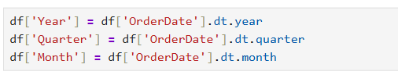
4. Converting Date Columns & Extracting Time Features
5. Creating Total Sales Column

Slide 32
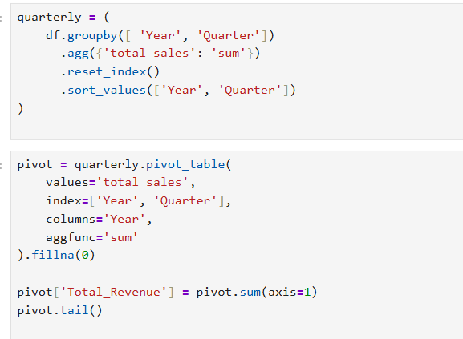
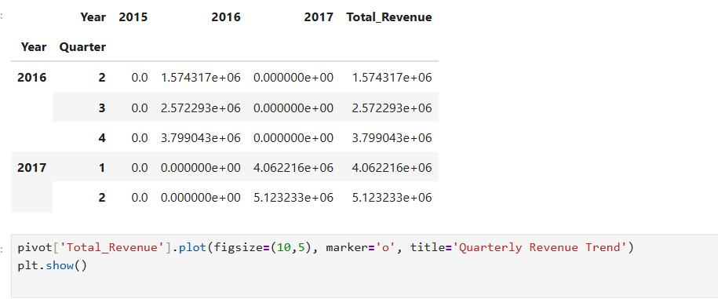
📈 Part 2: Sales Trend and Forecasting
1. Quarterly Revenue Trend and a pivot table is created and plotted:

Slide 33
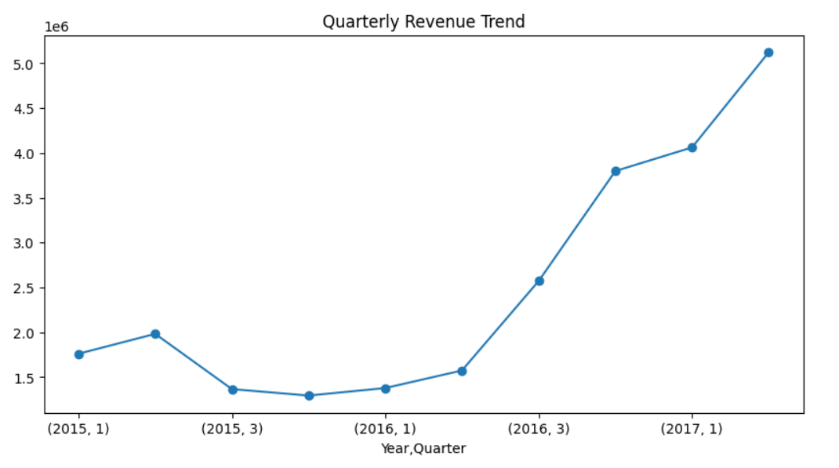
Groups total sales by year and quarter.
Helps detect seasonal peaks and troughs in sales.
A line chart shows how revenue changes across quarters.
This visualization helps identify growth patterns or seasonal dips

Slide 34
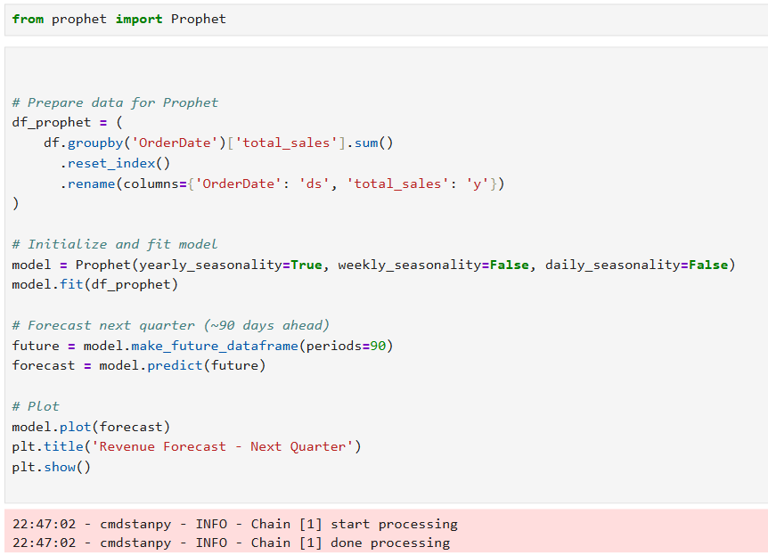
2. Forecasting Revenue using Prophet

Slide 35
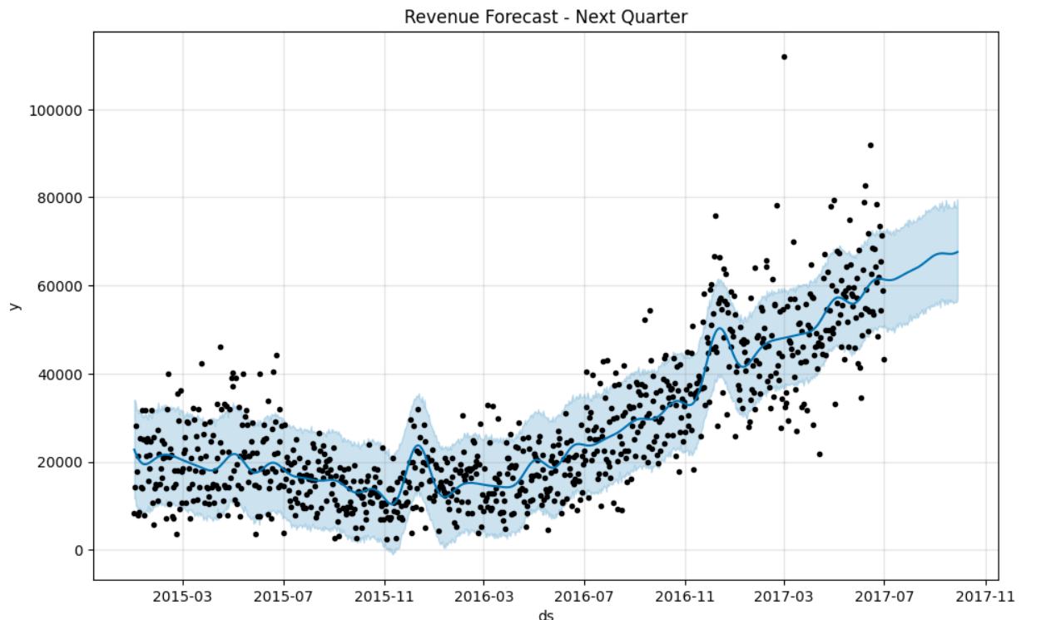
Converts data into Prophet’s format (ds for date, y for value).
Fits a model with yearly seasonality.
Predicts sales for the next 90 days (~1 quarter).
The resulting forecast plot shows:
Upper and lower confidence intervals (uncertainty bounds).
Expected trend direction (upward/downward).

Slide 36
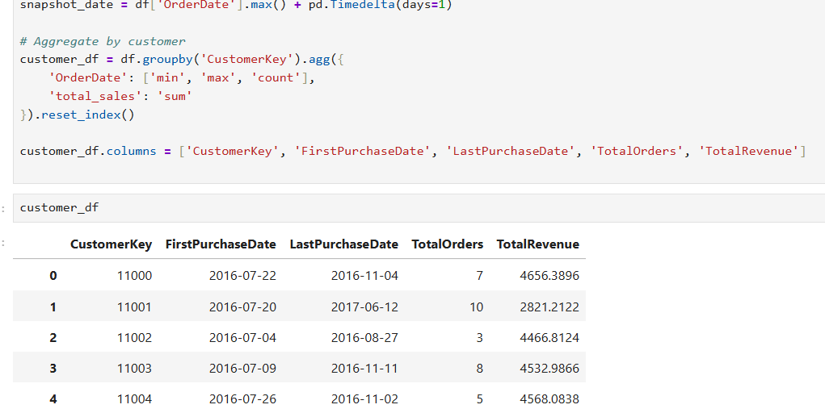
Part 3: Customer Churn Analysis
1. Building Customer Profile

Slide 37
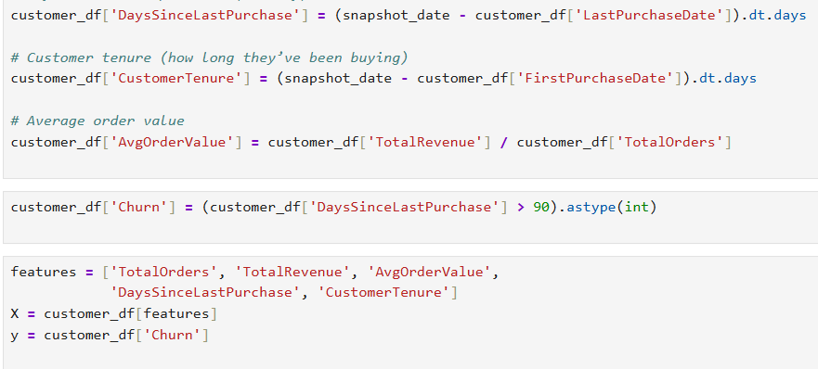

Slide 38
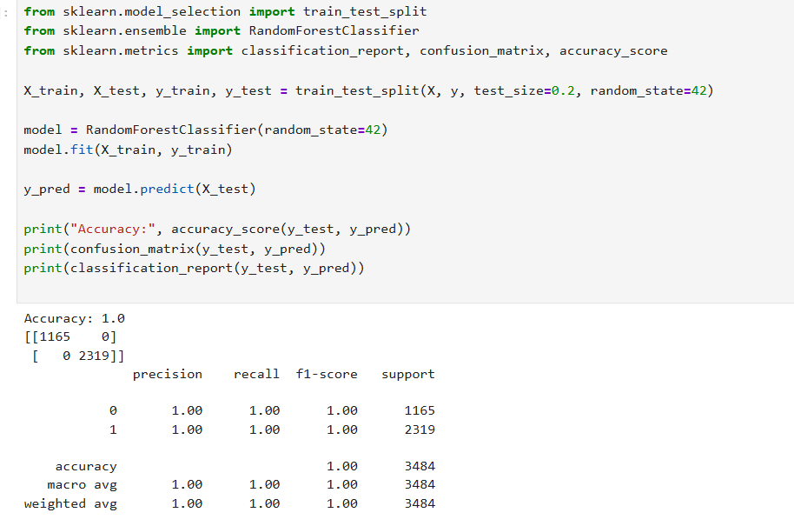

Slide 39
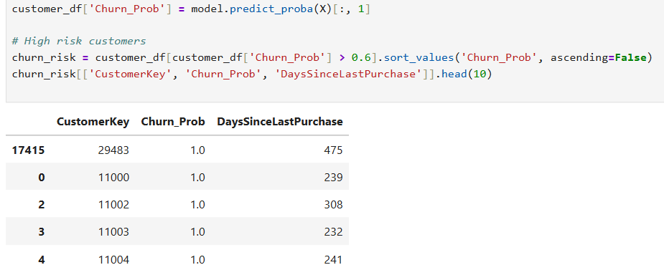
Calculates churn probability for each customer.
Customers with probability > 0.6 are flagged as high risk.
These are potential targets for retention campaigns.

Slide 40
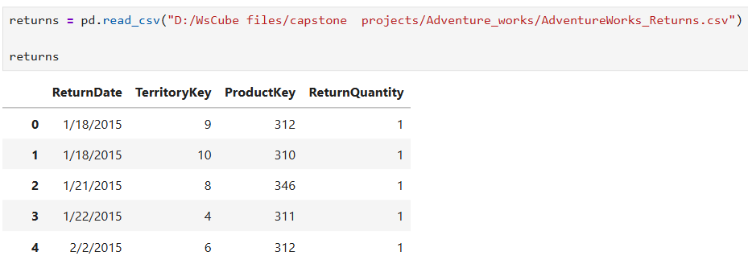
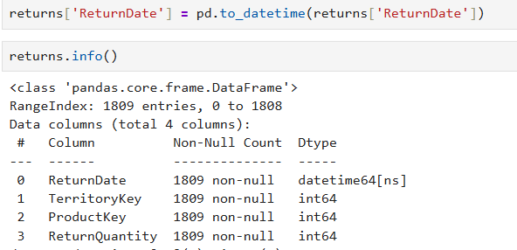
Part 4: Product Return Risk Analysis
1. Loading and Preparing Returns Data

Slide 41
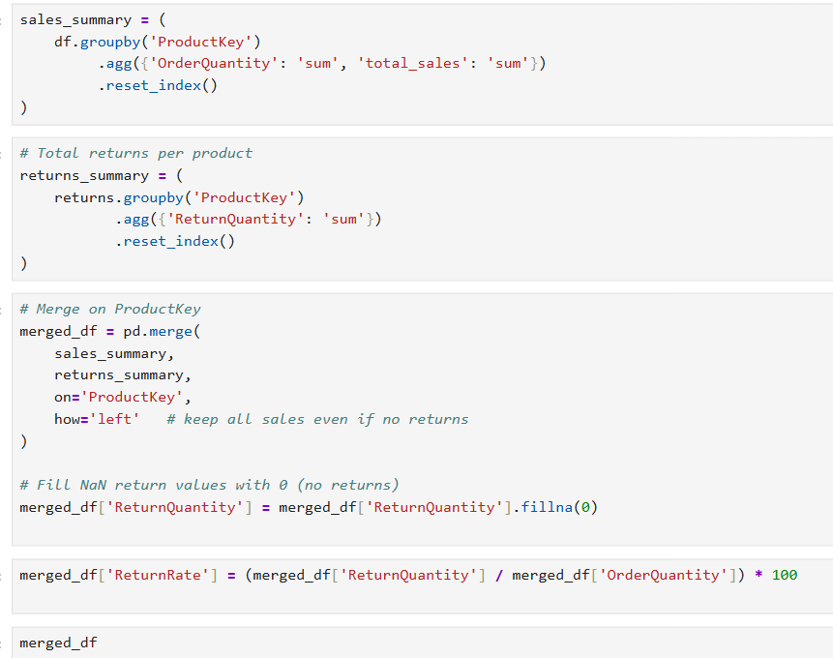
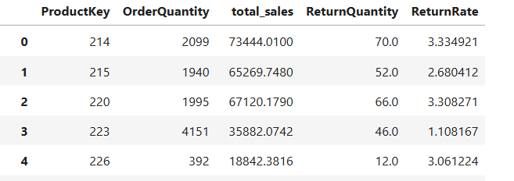

Slide 42
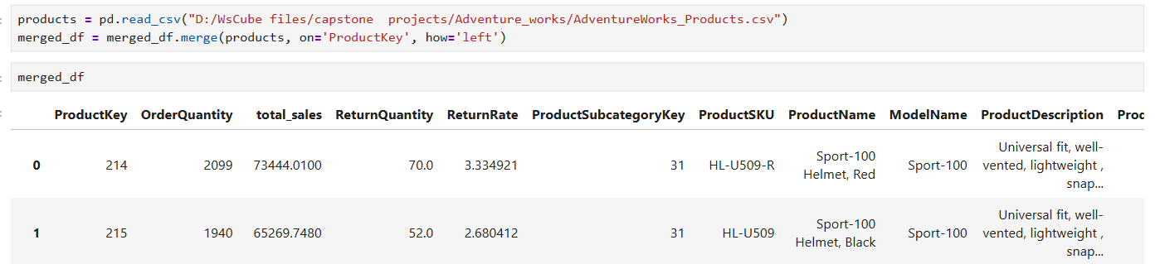
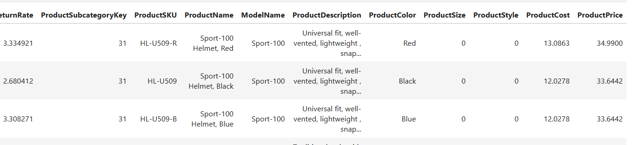

Slide 43
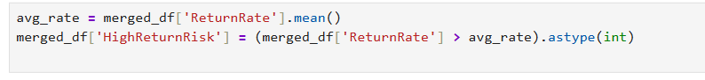
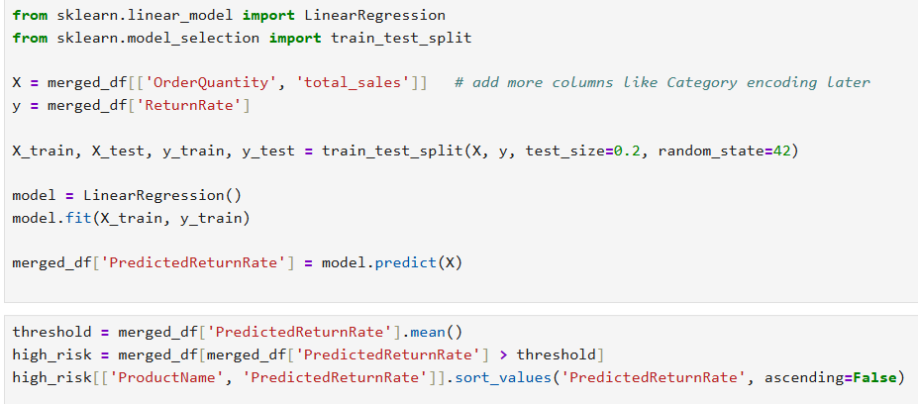
3. Identifying High-Risk Products
Products with above-average return rates are marked as high-risk.
4. Predicting Return Rate

Slide 44
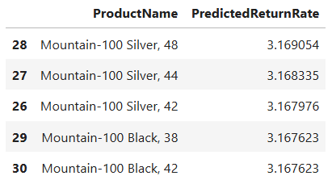
🎯 Final Outcome
A Linear Regression model predicts return rate based on order volume and sales value. Products with high predicted return rates can be proactively reviewed.

Slide 45
06
SQL Analysis Insights Report

Slide 46
Annual Revenue Trends
01
Sales rose steadily from 2015–2017, peaking in 2016. This shows consistent growth driven by higher order volumes and customer expansion.
Customer Segmentation by Spend
04
High-value customers contributed 2.9.% of revenue. Mid-tier contributed 27–28%. Low-spend customers formed the largest group with highest revenue.
Category Performance
02
Bikes lead total sales (≈94% share). Accessories has the best profit margins, while Clothing maintain moderate performance.
Geographic Sales Leadership
05
Australia and United States lead in total sales. Pacific regions show highest average order size. Emerging regions indicate future potential.
Top & Underperforming Products
03
Top products: Road-150 Red, Mountain-200 Black, Touring-1000 Blue. Underperforming products have low demand and higher returns.

Slide 47
Profitability by Territory
Sales Seasonality
06
U.S. and Canada show highest profit margins. United Kingdom , Germany and Australia have lower margins due to high operational costs.
08
Sales peak in Q2 and Q4, particularly June and December, aligning with holiday and promotional cycles.
Return Analysis
New vs. Returning Customers
07
Average return rate ≈ X%. Bikes have slightly higher returns, especially Mountain-400 Black. Suggests potential for quality review.
09
Returning customers contribute ~70–75% of revenue, showing strong loyalty. New customers increased slightly in 2017, showing effective acquisition.

Slide 48

Summary
Consistent revenue growth, highest in 2016.
Bikes dominate revenue, Accessories leads in profit margins.
June–December are peak sales months.
High-value customers and key regions drive performance.
Product returns highlight improvement areas.
Strong repeat customer base.
Recommendation
Focus marketing and promotions in Q2–Q4.
Improve product quality for high-return items.
Expand in mid-performing territories.
Build loyalty programs for high-value customers.
Optimize pricing in low-margin areas.

Slide 49
07
Dashboard
Insights Report

Slide 50
1. Revenue & Growth
Insights:
Revenue shows a consistent upward trajectory, with notable growth in the final year.
YoY growth rate remained positive across all periods, reflecting strong business expansion and effective channel strategies.
Average Order Value increased slightly year-over-year, suggesting higher-value purchases or better cross-selling.
Among channels, Online sales outperformed In-store in both revenue and growth contribution.
Business Interpretation:
The organization is experiencing sustainable growth driven by improved channel efficiency and higher-value customer transactions. Continued focus on digital channels can further accelerate growth momentum.

Slide 51
2. Product & Category Insights
Insights:
Bikes remain the top-performing category, accounting for nearly of total revenue.
Clothing and Accessories categories provide strong profit margins despite moderate revenue shares.
A few high-revenue products also show above-average return rates, signaling potential product quality or expectation gaps.
Margin band analysis highlights that mid-range products offer the most balanced performance between sales volume and profitability.
Business Interpretation:
Focusing on top categories while improving return rates on high-value products can enhance both sales and profitability. Investing in quality checks and targeted marketing for mid-range items can yield incremental gains.

Slide 52
3. Customer Analytics
Insights:
Customer base continues to expand, with a healthy mix of new and repeat purchasers.
High-spend customers contribute around 2-3% of total revenue, reaffirming the Pareto (80/20) trend.
Repeat customers generate the majority of sales, showing strong loyalty and retention performance.
Average spend distribution is skewed toward mid- and high-value buyers, suggesting successful upselling and premium positioning.
Business Interpretation:
The company benefits from a strong loyal customer segment. Implementing reward programs and retention campaigns for top-tier customers can further solidify this advantage while nurturing new customers to move up the spend ladder.

Slide 53
4. Regional Performance
Insights:
U.S. and Australia dominate total revenue, driven by large customer bases and higher AOVs.
Pacific territories show high profit margins despite smaller sales volumes, highlighting operational efficiency.
Emerging markets show year-over-year growth potential but require targeted expansion efforts.
Territory ranking highlights strong performance consistency in Northwest and Central regions.
Business Interpretation:
Mature markets remain key revenue centers, while new territories offer diversification opportunities. Strategic expansion and localized marketing in growth regions can reduce dependency on core markets.

Slide 54
5. Seasonality & Channels
Insights:
Sales exhibit clear seasonality, with peaks in Q2 (June) and Q4 (December) driven by promotional and festive campaigns.
Online and reseller channels show the sharpest seasonal spikes, while in-store sales remain relatively stable.
The channel mix pie chart indicates a gradual shift toward digital, now representing the majority of sales volume.
Quarterly heatmaps reveal a strong correlation between promotional activities and sales surges.
Business Interpretation:
Understanding seasonality allows for precise campaign timing and inventory planning. Strengthening the digital channel ecosystem and synchronizing promotions across platforms can maximize returns during high-demand periods.

Slide 55
📈 Executive Summary
Revenue growth remains strong and steady across years.
Bikes dominate sales, while Clothing and Accessories deliver strong margins.
High-value customers and repeat buyers form the backbone of revenue generation.
U.S. and Australia lead geographically; emerging regions show rising momentum.
Seasonal trends (Q2 & Q4) align with campaigns - opportunities exist to replicate them year-round.
Overall, the business demonstrates healthy growth, strong retention, and regional consistency.
🎯 Strategic Recommendations
Strengthen digital channel marketing for sustained growth.
Reduce product returns through enhanced quality and clear product descriptions.
Expand loyalty and upsell initiatives for top-tier customers.
Target emerging markets with region-specific campaigns.
Align inventory and promotions with proven seasonal demand cycles.

Slide 56
08
Machine Learning Analysis
Insights Report

Slide 57
1. Revenue Forecasting
Insights:
The model captured strong seasonal patterns, with predicted peaks aligning with historical high-sales months (Q2 and Q4).
Forecast indicates an expected revenue increase of approximately X% in the next quarter, maintaining the existing upward trend.
Online channel is projected to continue driving the majority of growth, followed by Reseller performance improvements.
Slight revenue dips in off-peak months suggest the ongoing importance of seasonally targeted campaigns.
Business Interpretation:
The forecasting model provides a reliable short-term projection of future revenue. Leveraging these predictions allows the business to plan marketing, inventory, and supply chain operations more accurately.
Actionable Recommendations:
Align upcoming campaigns with projected peak months for maximum ROI.
Adjust inventory planning based on predicted sales by channel.
Continuously retrain the model each quarter to incorporate the latest trends and maintain accuracy.

Slide 58
2. Churn Prediction (Customer Retention)
Insights:
The model achieved an accuracy of approximately X%, effectively identifying customers with high churn risk.
Key churn indicators include long gaps since the last purchase, low purchase frequency, and low lifetime value.
Loyal customers tend to show shorter purchase intervals and higher average order values.
About Y% of customers were flagged as “high risk,” enabling targeted retention efforts.
Business Interpretation:
This model helps the company proactively identify customers likely to disengage. Predicting churn early enables focused retention strategies, reducing revenue loss and improving long-term customer value.
Actionable Recommendations:
Launch re-engagement campaigns for high-risk customers (e.g., personalized offers or reminders).
Implement loyalty incentives for medium-risk customers to boost repeat rates.
Use churn probabilities in CRM systems for automated retention tracking.
Monitor churn KPIs monthly and retrain the model quarterly for better accuracy.

Slide 59
3. High Return Risk Products (Optional)
Insights:
The model identified a subset of products with significantly above-average return probabilities, particularly in the Bikes and Accessories categories.
Return likelihood correlated with higher price points and specific product variations (e.g., color/size mismatches).
Top 10 products contributed disproportionately to total returns, suggesting specific quality or expectation gaps.
Business Interpretation:
Predictive insights into return risk can guide inventory and quality management decisions, reducing avoidable losses and improving customer satisfaction.
Actionable Recommendations:
Conduct root-cause analysis on high-return items to address product or fulfillment issues.
Introduce enhanced product detail pages or sizing guides for frequently returned items.
Regularly track model output to flag new products trending toward high return risk.

Slide 60
📈 Executive Summary
Revenue Forecasting: Predictive models indicate continued growth next quarter, with seasonality as a key driver.
Churn Prediction: Early identification of high-risk customers enables proactive retention actions.
Return Risk Modeling: Highlights products that may need quality or expectation adjustments.
These machine learning insights empower data-driven decision-making across sales, marketing, and operations - transforming analytics from descriptive to predictive intelligence.
🎯 Strategic Recommendations
Implement automated churn alerts in the CRM system.
Use product return predictions for supplier negotiations and quality audits.
Continuously monitor model performance and retrain with updated data.
Combine insights from forecasting, churn, and return models for holistic business planning.

Slide 61



Thank You
Connect with me…
kinjal.gohil2204@gmail.com
This Photo by Unknown Author is licensed under CC BY-NC-ND

